Slide 1
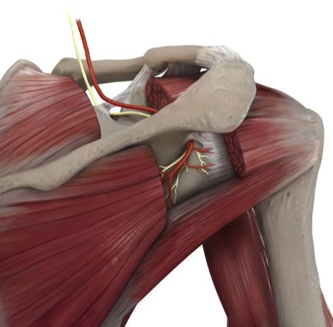
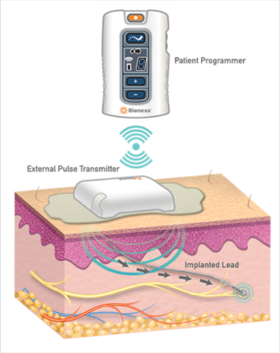
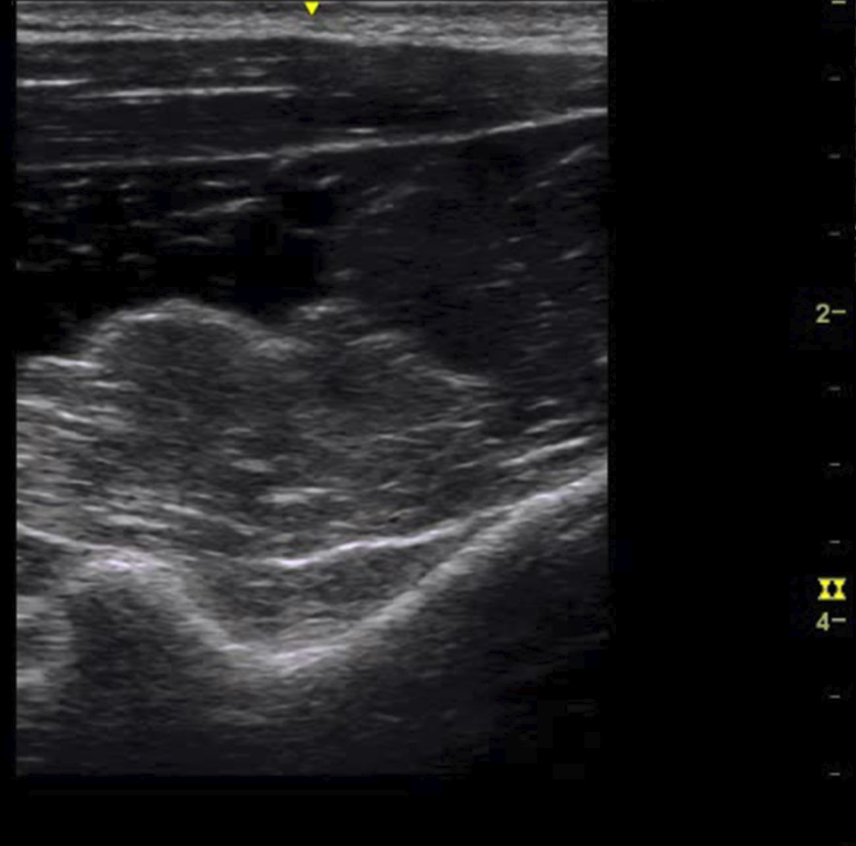
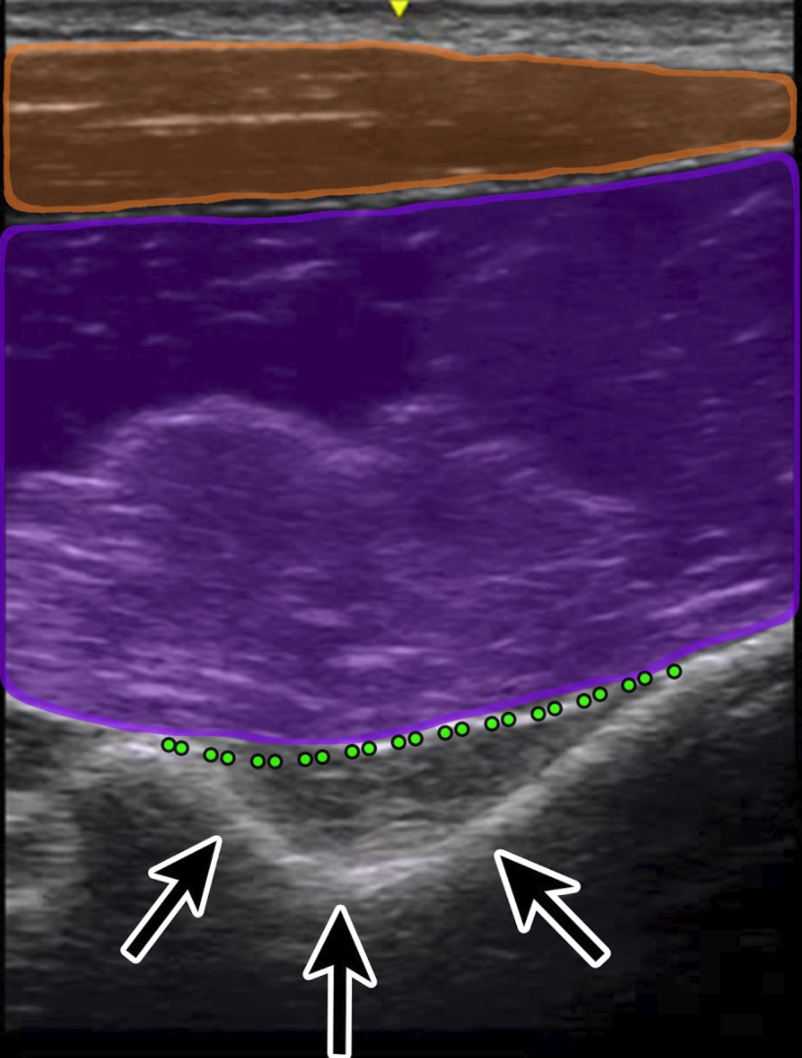
Novel Lead Placement for Suprascapular Nerve Peripheral Nerve Stimulation Adrian Darryll Sulindro MD, David Spinner DO, Michael Gofeld Department of Rehabilitation Medicine, Affiliate of the Icahn School of Medicine at Mount Sinai, New York, NY
Introduction
Case Description
Discussion
Peripheral nerve stimulation is often times used more for chronic musculoskeletal and nerve related pains. Peripheral nerve stimulation of the suprascapular nerve is one of the most common nerves targeted for shoulder pain. Here we demonstrate a new novel lead placement technique for suprascapular nerve stimulation.
An 82 year old male with chronic right shoulder pain, multifactorial in origin due to osteoarthritis, chronic rotator cuff tendinopathy and post herpetic neuralgia was evaluated for peripheral nerve stimulation. His pain is chronic in origin, having been present for over 10 years, was described as intense burning sensation, and rating a constant 8/10 on a numeric pain rating scale. Physical therapy, multiple medication trials with tricyclic antidepressants, antiepileptics, NSAIDs, platelet-rich plasma injections as well as stellate blocks have not provided any long lasting relief.
Diagnostic axillary and suprascapular nerve blocks significantly relieved different areas of his shoulder pain so a decision was made to place both an axillary and suprascapular nerve StimRouter lead. Theoretical discussion for the inferior approach through the spinoglenoid notch discussed first by Dr. Michael Gofeld.
With the patient sitting in a beach chair, the area over the posterior shoulder was evaluated under ultrasound using a 5 mHz curved array transducer. The probe was placed in the axial plane over the posterior glenohumeral joint, glenoid and medially the spinoglenoid notch over the scapula. The suprascapular nerve was identified along the suprascapular artery. Using an out-of- plane approach, from caudal to cephalad, an 18 gauge spinal needle was inserted 4 cm from the ultrasound probe. Once the tip of the needle was confirmed in the spinoglenoid notch,it was passed superiorly into the suprascapular notch, the ultrasound probe was re-positioned to identify the suprascapular notch and the needle tip was visualized underneath the superior transverse ligament. At this time, the guidewire was then passed through the spinal needle and confirmed in the suprascapular notch. Nerve stimulation reproduced a tingling sensation into the shoulder. The dilator was then placed along with the StimRouter lead. Repeat stimulation confirmed shoulder coverage and the lead was release. The receiver was tunneled laterally over the deltoid.
Patient returned for follow up appointment and continues >50% relief in his shoulder pain without any noted changes in function.
Shoulder pain is very important and prevalent in western society with a one-year prevalence of 4.7 - 46.7% (1). The etiology of chronic shoulder pain is very diverse and can include orthopedic conditions but also non-orthopedic causes such as cervical radiculopathy, and in our patients case also post herpetic neuralgia. This can limit a patient's ability for his daily activities and causes burdens on both the patient and society around him. The suprascapular nerve is considered one of the important nerves in the shoulder region. It contains both the motor fibers to the supraspinatus and infraspinatus muscles, and is a major part of sensory innervation of the shoulder which also includes the axillary nerve. These two nerve are important targets for chronic shoulder pains which can cover various pathologies including orthopedic causes, iatrogenic causes as well as hemiplegic shoulders.(2,3). Pain relief of the shoulder can be achieved by nerve blocks (using bupivacaine and methylprednisolone acetate) for a short term effect, as well as radiofrequency for a longer term effect (4). A percutaneous approach for peripheral nerve stimulation seems to be an ideal approach to provide pain relief coverage to the proximal branches to acromion and subacromial regions. Using ultrasound, the usual site of entry involves visualization and scanning at the superior medial border of the scapula and identifying the suprascapular fossa with imaging of the supraspinatus muscle and finally the suprascapular nerve underneath it. (5)
In our patient, a novel ultrasound guided inferior approach through the spinoglenoid notch was performed.Using this technique, potential complications of suprascapular nerve block may be avoided, based on using ultrasound as well as by staying on the scapula. Pneumothorax has been reported following suprascapular nerve block and is a concerning source of litigation (6). A technique described to stimulate the distal branches of the suprascapular nerve (7) was postulated to create a more stable lead position without migration and this may also be another benefit to using this posterior inferior approach.
Images
1
2
Conclusion
4
Based on a literature search on PubMed we have not been able to find a similar case of using an inferior approach through the spinoglenoid notch as a feasible effective technique for suprascapular nerve lead placement. This case study shows the viability of an inferior spinoglenoid notch approach for supraspinatus nerve peripheral nerve stimulation and may achieve better stability.
3
References
Luime, J. J., B. W. Koes, I. J. M. Hendriksen, Alex Burdorf, A. P. Verhagen, H. S. Miedema, and J. A. N. Verhaar. "Prevalence and incidence of shoulder pain in the general population; a systematic review." Scandinavian journal of rheumatology 33, no. 2 (2004): 73-81.
Chae, John, Richard D. Wilson, Maria E. Bennett, Tina E. Lechman, and Kathryn W. Stager. "Single‐Lead Percutaneous Peripheral Nerve Stimulation for the Treatment of Hemiplegic Shoulder Pain: A Case Series." Pain practice 13, no. 1 (2013): 59-67.
Elahi, Foad, and Chandan G. Reddy. "Neuromodulation of the suprascapular nerve." Pain physician 17, no. 6 (2014): E769-73.
Shah, Rinoo V., and Gabor B. Racz. "Pulsed Mode Radiofrequency Lesioning to Treat Chronic Post‐tonsillectomy Pain (Secondary Glossopharyngeal Neuralgia)." Pain Practice3, no. 3 (2003): 232-237.
Harmon, Dominic, and Conor Hearty. "Ultrasound-guided suprascapular nerve block technique." Pain Physician 10, no. 6 (2007): 743.
Fitzgibbon, Dermot R., Karen L. Posner, Karen B. Domino, Robert A. Caplan, Lorri A. Lee, and Frederick W. Cheney. "Chronic Pain ManagementAmerican Society of Anesthesiologists Closed Claims Project." Anesthesiology: The Journal of the American Society of Anesthesiologists 100, no. 1 (2004): 98-105.
Erkan Kurt, M. D., M. D. Tess van Eijk, M. D. Dylan Henssen, and N. P. Inge Arnts. "Neuromodulation of the Suprascapular Nerve." Pain physician 19 (2016): E235-E239.
Anatomical entry of inferior spinoglenoid notch approach
Bioness Peripheral nerve stimulator
Coronal Suprascapular nerve US imaging
Orange: Trapezius: Purple: supraspintus, arrows: supraspinatus notch green: suprascapular ligament

